Slide 1

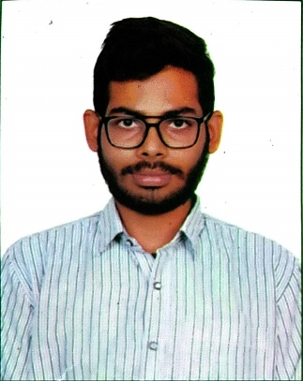



ABDULLAH SHAIK
Education and certificates
Bachelor of Engineering in
Electrical and Electronics : 2017-2021
Analyst/Software Engineer
Base Location: MUMBAI
Email ID:
SHAIK.ABDULLAH@CAPGEMINI.COM
Skills
Mobile No: +918074164126
Grade: A4
EMP ID-46205918
Java | Basics, OOPS, Exception Handling, Collections & Generics, Java 8 Features
Spring Framework | Spring MVC. Spring JDBC, Spring-ORM, Spring Boot
React | Components, Hooks, Virtual DOM, Routing, Forms & Validation
RDBMS | MySQL,Oracle
UI Technology | HTML 5, CSS, JavaScript
Tools | Git ,GitHub, Postman, Eclipse, Visual Studio code
Add On Skills | Communication , Team management
Strengths
Full Stack Developer
Good Knowledge of java programming.
Achievement
ONLINE EXAM PORTAL
Case study of Online Exam Portal System along with Spring Boot, HTML5, CSS and React used as User Interface.
•Good with Spring Framework
•Good in developing web pages using HTML, CSS.
•Currently learning on iTransform: Full Stack With React, Spring Boot MS & MongoDB
Full Stack developer with React and Full Stack Java Developer
Four layered architecture which includes a Presentation Layer, Business Layer, Persistence Layer and Database Layer. Exception Layer handled the exceptions.
Hands on experience in developing web pages
using HTML5, CSS3, REACT. Good understanding of Document Object Model (DOM) and DOM Functions.
Proficient in creating Single page Web Application in
REACT with routing.
Presentation Title | Author | Date © Capgemini 2017. All rights reserved | 1

